Slide 1
6/11/26, 12:59 PM swiggy-project
SWIGGY SALES ANALYSIS
IMPORT LIBRARIES
In [24]:
import pandas as pd
import numpy as np
import matplotlib.pyplot as plt
import seaborn as sns import plotly.express as px import plotly.io as pio
pio.renderers.default = "notebook"
IMPORT LIBRARIES
In [25]:
df = pd.read_excel("C:/Users/L470/Desktop/project-swiggy/swiggy_data.xlsx")
In [26]:
df.head()
Out[26]:
State City Order Date Restaurant Name Location Category Dish Name Price (INR) Rating Rating Count
0 Karnataka
Bengaluru
2025-06-29
Anand Sweets & Savouries
Rajarajeshwari Nagar
Snack Butter Murukku-200gm
133.9 4.0
0
1 | Karnataka | Bengaluru | 2025-04-03 | Srinidhi Sagar Deluxe | Kengeri | Recommended | Badam Milk | 52.0 | 4.5 | 25
2 | Karnataka | Bengaluru | 2025-01-15 | Srinidhi Sagar Deluxe | Kengeri | Recommended | Chow Chow Bath | 117.0 | 4.7 | 48
3 | Karnataka | Bengaluru | 2025-04-17 | Srinidhi Sagar Deluxe | Kengeri | Recommended | Kesari Bath | 65.0 | 4.6 | 65
4 | Karnataka | Bengaluru | 2025-03-13 | Srinidhi Sagar Deluxe | Kengeri | Recommended | Mix Raitha | 130.0 | 4.0 | 0
In [27]:
df.tail()
Out[27]:
State City Order Date Restaurant Name Location Category Dish Name Price (INR) Rating Rating Count
197425
Sikkim
Gangtok2025-01-25
Mama's Kitchen GangtokMomos Soya cheese chilli momo ...
112.0 4.4
0
197426 | Sikkim | Gangtok | 2025-07-02 | Mama's Kitchen | Gangtok | Momos | Kurkure momo fried ... | 140.0 | 4.4 | 0
197427 | Sikkim | Gangtok | 2025-03-25 | Mama's Kitchen | Gangtok | Momos | Chilli cheese momo | 126.0 | 4.4 | 0
197428 | Sikkim | Gangtok | 2025-03-26 | Mama's Kitchen | Gangtok | Momos | Veg Momos (8 Pc) | 85.0 | 4.4 | 0
197429 | Sikkim | Gangtok | 2025-03-27 | Mama's Kitchen | Gangtok | Momos | Soya Momo | 100.0 | 4.4 | 0
Metadata
In [28]:
print("No of rows:",df.shape[0])

Slide 2
6/11/26, 12:59 PM swiggy-project
No of rows: 197430
In [29]:
print("No of fields:",df.shape[0])
No of fields: 197430
In [30]:
df.info()
< class 'pandas.core.frame.DataFrame' >
RangeIndex: 197430 entries, 0 to 197429 Data columns (total 10 columns):
# Column Non-Null Count Dtype
- -------------- -----
---
0 State
-----
197430 non-null object
1 | City |  | 197430 | non-null | object
2 | Order Date |  | 197430 | non-null | datetime64[ns | ]
3 | Restaurant | Name | 197430 | non-null | object
4 | Location |  | 197430 | non-null | object
5 | Category |  | 197430 | non-null | object
6 | Dish Name |  | 197430 | non-null | object
7 | Price (INR) |  | 197430 | non-null | float64
8 | Rating |  | 197430 | non-null | float64 | 9 | Rating | Count | 197430 | non-null | int64 | dtypes: | datetime64[ns](1), | float64(2), | int64(1), | object(6) | memory
usage: 15.1+ MB
Data Types
In [31]: Out[31]: In [32]: Out[32]: | df.dtypes State object City object Order Date datetime64[ns] Restaurant Name object Location object Category object Dish Name object Price (INR) float64 Rating float64 Rating Count int64 dtype: object df.describe() Order Date Price (INR) | Rating | Rating Count
count 197430 197430.000000 197430.000000
197430.000000
mean | 2025-05-01 19:41:20.996808960 | 268.512920 | 4.341582 | 28.321805
min | 2025-01-01 00:00:00 | 0.950000 | 1.500000 | 0.000000
25% | 2025-03-01 00:00:00 | 139.000000 | 4.300000 | 0.000000
50% | 2025-05-02 00:00:00 | 229.000000 | 4.400000 | 2.000000

Slide 3
6/11/26, 12:59 PM swiggy-project
75% | 2025-07-01 00:00:00 | 329.000000 | 4.500000 | 15.000000
max | 2025-08-31 00:00:00 | 8000.000000 | 5.000000 | 999.000000
std | NaN | 219.338363 | 0.422585 | 87.542593
KPI'S
Total Sales
In [33]:
Total_Sales=df["Price (INR)"].sum() print("Total_Sales (INR):",round(Total_Sales,2))
Total_Sales (INR): 53012505.77
Average Rating
In [34]:
Average_Rating=df["Rating"].mean() print("Average Rating:",round(Average_Rating,2))
Average Rating: 4.34
Average Order Values
In [35]:
Average_order_values=df["Price (INR)"].mean() print("Average_order_value(INR):",round(Average_order_values,2))
Average_order_value(INR): 268.51
Ratings Count
In [36]:
Ratings_Count=df["Rating Count"].sum() print("Ratings_Count:",round(Ratings_Count,2))
Ratings_Count: 5591574
Total Orders
In [37]:
Total_Orders=len(df) print("Total_Orders:",round(Total_Orders,2))
Total_Orders: 197430
CHARTS DESIGN
Monthly Sales Trend

Slide 4
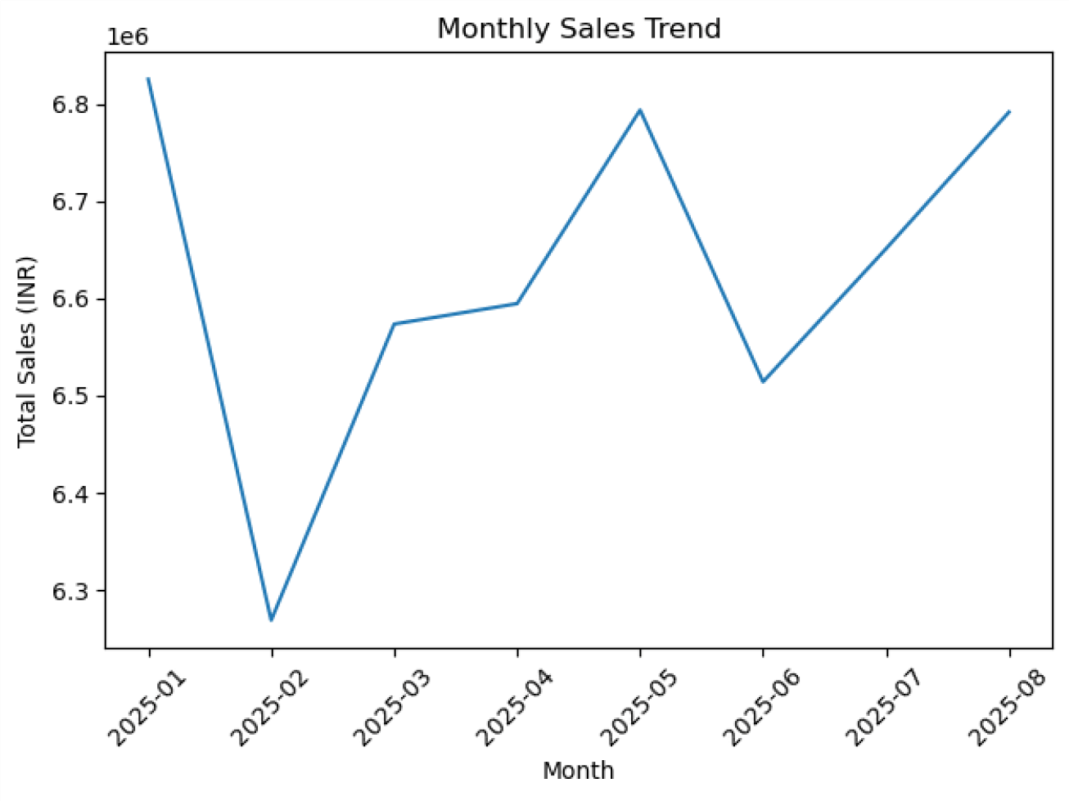
6/11/26, 12:59 PM swiggy-project
In [38]:
df["Order Date"] = pd.to_datetime(df["Order Date"]) df["YearMonth"] =
df["Order Date"].dt.to_period("M").astype(str) monthly_revenue =
df.groupby("YearMonth")["Price (INR)"].sum().reset_index()
plt.figure() plt.plot(monthly_revenue["YearMonth"],monthly_revenue["Price (INR)"]) plt.xticks(rotation=45) plt.xlabel("Month") plt.ylabel("Total Sales (INR)") plt.title("Monthly Sales Trend") plt.tight_layout() plt.show()
Daily Sales Trend
df["DayName"] = pd.to_datetime(df["Order Date"]).dt.day_name()
daily_revenue = ( df.groupby("DayName")["Price (INR)"]
.sum()
.reindex(["Monday","Tuesday","Wednesday","Thursday","Friday","Saturday","Sunday"])
)
plt.figure(figsize=(10,5)) plt.bar(daily_revenue.index,daily_revenue.values) plt.title("Daily Revenue Trend (Mon-Sun)")

Slide 5
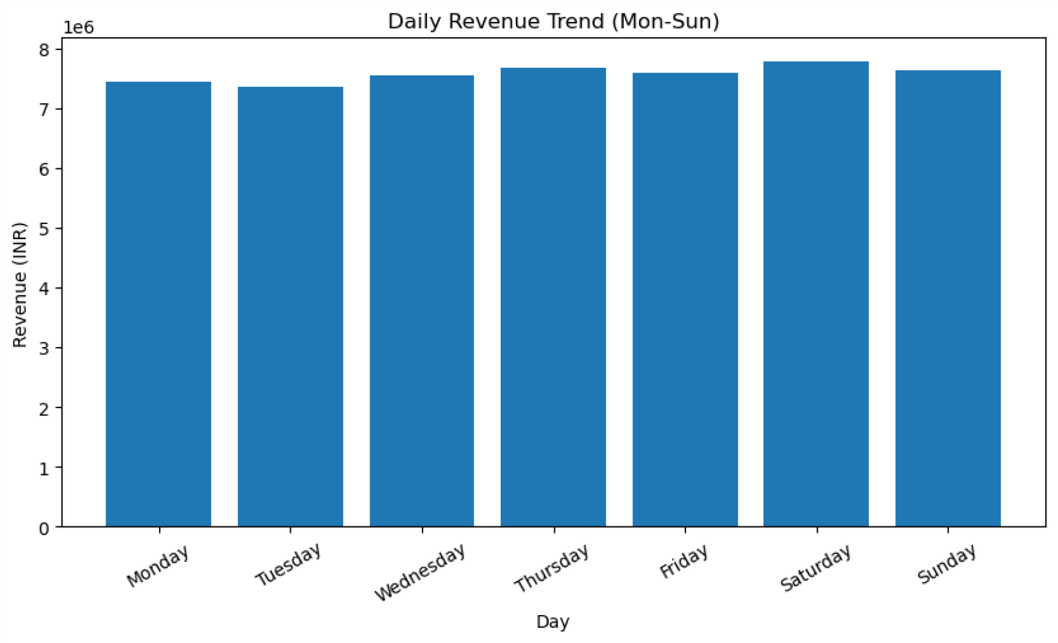
6/11/26, 12:59 PM swiggy-project
In [39]:
plt.xlabel("Day") plt.ylabel("Revenue (INR)") plt.xticks(rotation=30)
plt.show()
Total Sales by Food Type(Veg vs Non-Veg)
non_veg_keywords =[ "chicken","egg","fish","mutton",
"prawn","biryani","kebab", "non-veg","non veg"
]
df["Food Category"]= np.where( df["Dish Name"].str.lower().str.contains("|".join(non_veg_keywords),na=False) ,
"Non-Veg", "Veg"
)
food_revenue =( df.groupby("Food Category")["Price (INR)"]
.sum()
.reset_index()
)

Slide 6
6/11/26, 12:59 PM swiggy-project
In [40]:
In [41]:
In [42]:
fig = px.pie( food_revenue, (INR)", names="Food Category",
values="Price hole=0.5,
title="Revenue Contribution: Veg vs Non-Veg",
)
fig.update_traces(
textinfo="percent+label", pull=[0.05,0]
)
fig.update_layout( height=500, margin=dict(t=60,b=40,l=40,r=40)
)
fig.show()
Revenue Contribution: Veg vs Non-Veg
Veg
Non-Veg
Non-Veg
37%
Veg 63%

Slide 7
6/11/26, 12:59 PM swiggy-project
Total Sales by State
fig = px.bar( df.groupby("State", as_index=False)["Price (INR)"].sum()
.sort_values("Price (INR)", ascending=False) , x="Price (INR)", y="State",
orientation="h", title="Revenue by State (INR)"
In [43]:
)
fig.update_layout(height=600, yaxis=dict(autorange="reversed")) fig.show()
Revenue by State (INR)
Karnataka Uttar Pradesh Telangana Maharashtra
Delhi Gujarat Punjab West Bengal Tamil Nadu Rajasthan
Madhya Pradesh
Goa Haryana Meghalaya Himachal Pradesh
Jammu and Kashmir
Uttarakhand
Kerala Assam Manipur
Bihar Chhattisgarh Jharkhand
Odisha Tripura
Mizoram
Nagaland Sikkim
0
1M
2M
3M
Price (INR)
4M
5M
Quarterly Performance Summary
In [44]:
Out[44]:
Quarter
df["Order_Date"] = pd.to_datetime(df["Order Date"]) df["Quarter"] = df["Order_Date"].dt.to_period("Q").astype(str) quarterly_summary=( df.groupby("Quarter" , as_index=False)
.agg(
Total_Sales=("Price (INR)","sum") , Average_Rating=("Rating","mean") , Total_Orders=("Order_Date","count")
)
Total_Sales Average_Rating Total_Orders

Slide 8
6/11/26, 12:59 PM swiggy-project
.sort_values("Quarter")
)
quarterly_summary["Total_Sales"]=quarterly_summary["Total_Sales"].round(0) quarterly_summary["Average_Rating"]=quarterly_summary["Average_Rating"].round(2) quarterly_summary
0 2025Q1 | 19667822.0 | 4.34 | 73096
1 2025Q2 | 19902257.0 | 4.34 | 74163
2 2025Q3 | 13442427.0 | 4.34 | 50171
Top 5 Cities by Sales
In [45]:
top_5_cities = ( df.groupby("City")["Price (INR)"]
.sum()
.nlargest(5)
.sort_values()
.reset_index()
)
fig = px.bar( top_5_cities, x="Price (INR)", y="City",
orientation="h", title="Top 5 Cities by Sales (INR)", color_discrete_sequence=["red"]
)
fig.show()

Slide 9
6/11/26, 12:59 PM swiggy-project
Top 5 Cities by Sales (INR)
Bengaluru
Lucknow
Hyderabad
Mumbai
New Delhi
0
1M
2M
3M
Price (INR)
4M
5M
In [ ]:

